Slide 1
2020 Summer session
Intelligent Care System
18309004 PARK HOIJAI
17309001 ANTONY
17309002 KIM TAESIK
18309003 ROH SUNGHO
18309004 SAM LINDAMAN
18309007 LEE EUN SOO
18309008 NABIL MADIH

Slide 2
CONTENTS
1
Project background
2
System analysis
3
Computer vision
4 Web
5 Timetable

Slide 3




1
Project background
SICK

Slide 4
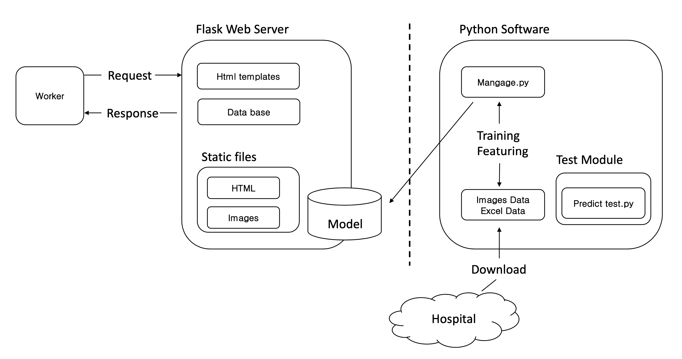
2
System configuration

Slide 5
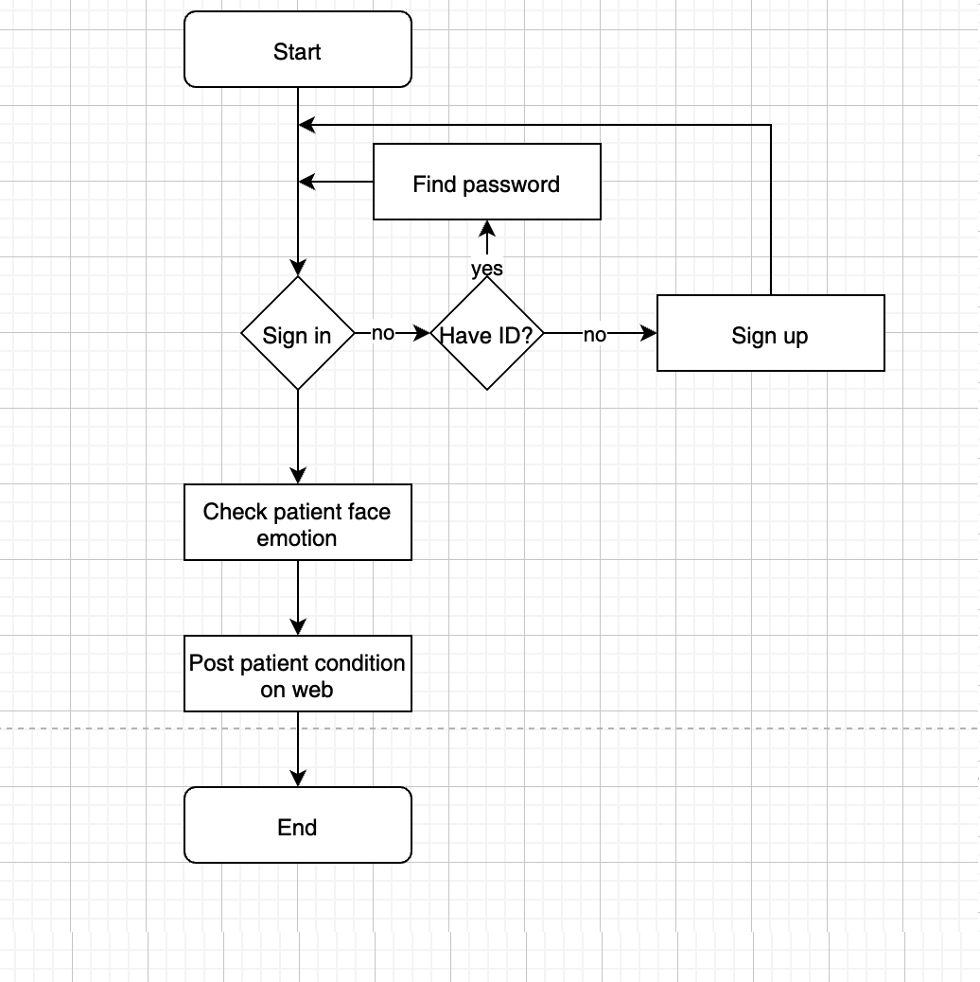
2
Flow Chart

Slide 6
2.1
functional requirements
Worker should check patients condition via patients emotion
Worker should record patients condition on web
Worker should check patients information on web
SICK

Slide 7
2.3
Non-functional requirements
Performance: The function used by the user should present an output in less than 3 seconds.
Reliability: The function must be able to recognize the subject’s face with 99% probability.
Security: Only registered users should be able to access the system
Safety: This web should not use any memory after it is closed.
Availability: This system must provide its service for 24 hours a day,365 days a year.

Slide 8
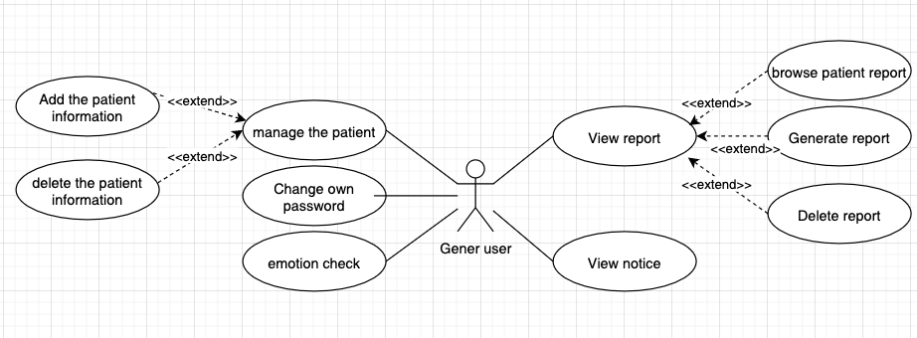
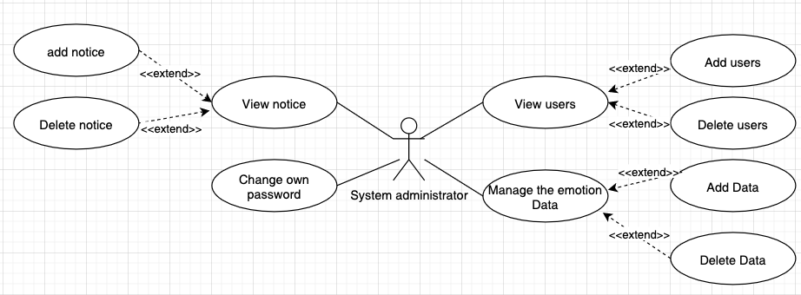
2.3
Requirements and Task Analysis
General user
System administrators

Slide 9
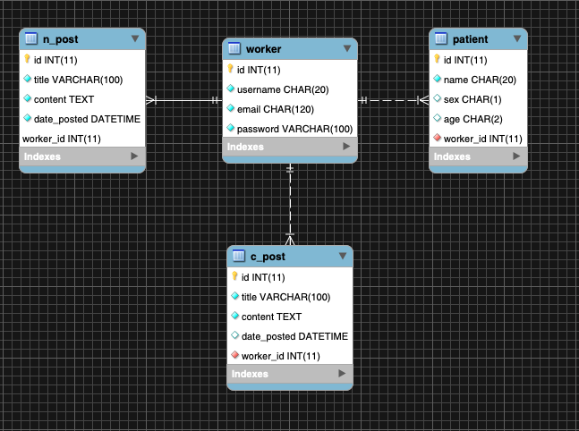
2
ER-diagram

Slide 10
2
Table
[Worker]
[Patient]
Column name | Type | Description
Id | INT(11) | Worker ID
Username | CHAR(20) | Worker Usename
Email | CHAR(120) | Worker email
Password | VARCHAR(100) | Worker password
Column name | Type | Description
Id | INT(11) | Patient number
Name | CHAR(20) | Patient name
Sex | CHAR(2) | Patient sex
Age | CHAR(1) | Patient age
Worker id | INT(11)
[C_Post]
[N_post]
Column name | Type | Description
Id | INT(11) | Post number
Title | VARCHAR(100) | Patient information title
Content | TEXT | Patient information content
Data_posted | DATETIME | Post data
Worker_id | INT(11) | Worker ID
Column name | Type | Description
Id | INT(11) | Post number
Title | VARCHAR(100) | Notice title
Content | TEXT | Notice content
Data_poshed | DATETIME | Post date
Worker_id | INT(11) | Admin ID

Slide 11
3
Computer Vision
What is Computer Vision?
Computer vision is a type of AI that trains computers to “see” and understand the visual world. Digital media via cameras send photos and videos to machine learning models, and these models can then accurately identify and classify objects within the media.

Slide 12
3.1
CV Goal
The intent of our computer vision model is to track the face of an individual in front of their webcam, and with a high degree of accuracy, classify and display the emotions on the face of the user. This model will be extended to classify the users as sick or healthy depending on their facial features and expression.

Slide 13
3.2
Technology used
Python
OpenCV
Numpy
Keras learning
Matlab Plotting
Built-in / USB webcam

Slide 14
3.3
Implementation
Our computer vision technology will be implemented through the use of python scripts, that will be run on a web server that is accessible to anyone with an internet connection and a webcam.
A user will only need to login to the system, and allow access to their webcam. The implementation of computer vision modeling will then be able to classify the user into a category of emotion, and determine them as sick or healthy.

Slide 15
3.4
Data Training
OpenCV uses a system of training called cascade data training.
In this model, a set of target (positive) images containing what is meant to be recognized must be classified, as well as a set of arbitrary (negative) images.
The ML model then iterates through each dataset and defines the trained data in a cascade .xml file. This is the file that is used to compare and classify incoming data not belonging to the training data set.

Slide 16
4
web
[Initial screen]
[Main screen]
1_ Manage the patients
2_ Emotion check
3_Write the report

Slide 17
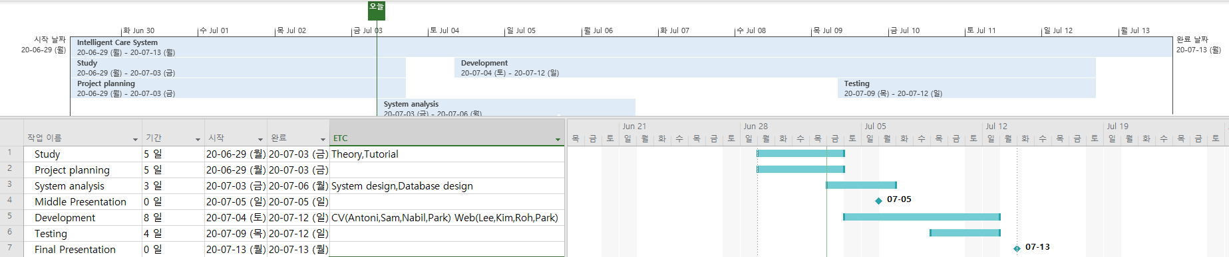
5
Ghantt chart
CV Part: Antoni , Sam, Nabil, Park
Web Part: Lee, Kim, Roh, Park

Slide 18

Thank you

